Slide 1
Advanced Java programming in
J2EE
Chapter 1
Introducing J2EE
Notes:
Book Reference: Your First Cup: An Introduction to the Java TM EE Platform – By Oracle

Slide 2
Topics To Be Learnt
J2EE Introduction
J2EE Platform Technologies at a Glance
Sun Java Application Server
Notes:
Ch.1 Topics → from Sau Uni MCA-III Syllabus.

Slide 3
Java Basics…
Java Technology is both a Programming Language and a Platform.
Programming language :
  is a high-level object-oriented Language that has a particular Syntax and Style.
Platform :
  is a Particular Environment in which Java Programming Language Applications(API) run.
There are Several Java Platforms(next slide).
Many Developers, even long-time Java programming language developers, do not understand how the different platforms relate to each other.
Notes:
Java technology is both a programming language and a platform. The Java programming
language is a high-level object-oriented language that has a particular syntax and style. A Java
platform is a particular environment in which Java programming language applications run.
There are several Java platforms. Many developers, even long-time Java programming language
developers, do not understand how the different platforms relate to each other.

Slide 4
The Java Programming
Language Platforms
Java Platform, Standard Edition (Java SE)
Java Platform, Enterprise Edition (Java EE)
Java Platform, Micro Edition (Java ME)
Java FX (Form Following Function)
Notes:
Pg. No. 13

Slide 5
Java Platform Basics…
All Java platforms consist of a Java VirtualMachine(VM) and an Application Programming Interface(API).
The Java VirtualMachine is a program, for a particular hardware and software platform, that runs Java technology applications.
An API is a collection of software components that you can use to create other software components or applications.
Notes:
All Java platforms consist of a Java VirtualMachine (VM) and an application programming
interface (API). The Java VirtualMachine is a program, for a particular hardware and software
platform, that runs Java technology applications. An API is a collection of software components
that you can use to create other software components or applications.

Slide 6
Java Platform Basics…
Each Java platform provides a Virtual Machine and an API, and this allows applications written for that platform to run on any compatible system with all the advantages of the Java programming language:
  Platform-Independence
  Power  Stability  Security
  Ease-of-Development
Notes:
Each Java platform provides a virtual machine and an API, and this allows applications written for that platform to
run on any compatible system with all the advantages of the Java programming language:
platform-independence, power, stability, ease-of-development, and security.

Slide 7
Java SE
When People think of the Java programming language, they think of the Java SE API.
Java SE's API provides the core functionality of the Java programming language.
From the basic types to high-level Classes.
Used for Networking, Security, Database access, Graphical User Interface (GUI) Development, and XML parsing.
Core API + VM + Development Tools + Deployment Tech. + Class Libs & Toolkits…
Notes:
When most people think of the Java programming language, they think of the Java SE API. Java
SE's API provides the core functionality of the Java programming language. It defines
everything from the basic types and objects of the Java programming language to high-level
classes that are used for networking, security, database access, graphical user interface (GUI)
development, and XML parsing.
In addition to the core API, the Java SE platform consists of a virtual machine, development
tools, deployment technologies, and other class libraries and toolkits commonly used in Java
technology applications.

Slide 8
Java EE
Built on top of the Java SE platform.
Provides an API and runtime environment for developing and running
  large-scale,
  multi-tiered,
  scalable,
  reliable, and
  secure network applications.
Notes:
The Java EE platform is built on top of the Java SE platform. The Java EE platform provides an
API and runtime environment for developing and running large-scale, multi-tiered, scalable,
reliable, and secure network applications.
Large-scale : a giant level application
Multi-tired : an application with different tiers like business tier, data tier etc…
Scalable : able to change in size, we can make it large or small as our requirements
Reliable : an application which can easily run on normal conditions as well as very hard situations
Secure : applications with security, that can not easily b hacked or cracked…!

Slide 9
Java ME
Provides an API and a small-footprint virtual machine for running Java programming language applications on small devices, like mobile phones.
The API is a subset of the Java SE API, along with special class libraries useful for small device application development.
Java ME applications are often clients of Java EE platform services.
Notes:
The JavaMEplatform provides an API and a small-footprint virtual machine for running Java
programming language applications on small devices, like mobile phones. The API is a subset of
the Java SE API, along with special class libraries useful for small device application
development. JavaMEapplications are often clients of Java EE platform services.

Slide 10
Java FX
Platform for creating rich internet applications written in Java FX Script.
Script is statically-typed declarative language that is compiled to Java technology bytecode, which can then be run on a Java VM.
Applications written for the Java FX platform can include and link to Java programming language classes, and may be clients of Java EE platform services.
Notes:
Java FX technology is a platform for creating rich internet applications written in Java FX Script.
Java FX Script is a statically-typed declarative language that is compiled to Java technology
bytecode, which can then be run on a Java VM. Applications written for the Java FX platform
can include and link to Java programming language classes, and may be clients of Java EE
platform services.

Slide 11
J2EE Introduction
It is designed to help developers to create:
  Large-Scale,
  Multi-Tiered,
  Scalable,
  Reliable
  &
  Secure
  Network Applications.
Notes:
Pg. No. 14

Slide 12
J2EE Introduction cont.
These Network Applications are designed to solve the problems encountered by large enterprises
that is why they are called…
Enterprise Applications…
Notes:
Pg. No. 14

Slide 13
J2EE Introduction cont.
Not only useful for
  Large Corporations
  Agencies, and
  Governments but
Helpful, Even Essential, for Individual Developers and Small Organizations in an Increasingly Networked World.
Notes:
Pg. No. 14

Slide 14
J2EE Introduction cont.
Security and Reliability make System Powerful but often they make applications complex.
The Java EE reduces the complexity of enterprise application development by:
  Development Model
  API and
  Runtime environment
Notes:
Pg. No. 15

Slide 15
Tiered Applications
The Functionality of the Application is Separated into Isolated Functional areas, called tiers.
Typically, Multi-Tiered Applications have
  a Client Tier,
  a Middle Tier,
  and a Data Tier (often called the enterprise information systems tier).
Notes:
Pg. No. 15

Slide 16
Tiered Applications
The Client Tier consists of a Client Program that makes Requests to the Middle Tier.
The Middle Tier's business function to handle Client Requests and Process Application Data, storing it in a Permanent DataStore in the Data Tier.
Java EE Concentrates on the Middle Tier to make Enterprise Application Management
  Easier,
  More Robust, and
  More Secure.
Notes:
Pg. No. 15

Slide 17
The Client Tier
Consists of Application clients that access a Java EE Server.
Located on a different machine from the Server.
The Clients make Requests to the Server.
The Server processes the Requests and Returns a Response Back.
Many different types of applications can be Java EE clients, and they are not always Java applications.
Clients can be a Web Browser, a Standalone Application, or other Servers, and they run on a different machine from the Java EE server.
Notes:
Pg. No. 15

Slide 18
The Web Tier
Consists of Components that handle the Interaction between Clients and the Business Tier.
Primary tasks:
  Dynamically generate content in various formats for the Client.
  Collect input from users of the Client interface and return appropriate results from the components in the Business Tier.
  Control the flow of screens or pages on the Client.
  Maintain the state of data for a user's session.
  Perform some basic logic and hold some data temporarily in JavaBeans components.
Notes:
Pg. No. 15

Slide 19
Java EE Technologies used in the
Web Tier
Servlets
JavaServer Faces Technology (JSF)
JavaServer Faces Facelets Technology
Expression Language
JavaServer Pages (JSP)
JavaServer Pages Standard Tag Library
JavaBeans Components
Notes:
Pg. No. 16

Slide 20
Servlets
Java Programming Language classes that dynamically process requests and construct responses, usually for HTML pages.
Notes:
Pg. No. 16

Slide 21
import java.io.*;
import javax.servlet.*;
import javax.servlet.http.*;
public class NewServletHelloWorld extends HttpServlet
{
protected void processRequest(HttpServletRequest request,
HttpServletResponse response) throws ServletException, IOException
{
response.setContentType("text/html;charset=UTF-8");
PrintWriter out = response.getWriter();
try {
out.println("<html>");
out.println("<head>");
out.println("<title>Servlet NewServletHelloWorld</title>");
out.println("</head>");
out.println("<body>");
out.println("<h1>Hello World...!</h1>");
out.println("</body>");
out.println("</html>");
}
finally { out.close(); }
}
}
Notes:
Sample code… no reference…

Slide 22
JavaServer Faces Technology
A user-interface component framework for web applications that allows you to include UI components (such as fields and buttons) on a page, convert and validate UI component data, save UI component data to server-side data stores, and maintain component state.
Notes:
Pg. No. 16

Slide 23
JavaServer Faces Facelets Technology
A type of JavaServer Faces applications that use XHTML pages rather than JSP pages.
Notes:
Pg. No. 16

Slide 24
Expression Language
A set of standard tags used in JSP and Facelets pages to refer to Java EE components.
Notes:
Pg. No. 16

Slide 25
JavaServer Pages(JSP)
Text-based documents that are compiled into servlets and define how dynamic content can be added to static pages, such as HTML pages.
Notes:
Pg. No. 16

Slide 26
<%--
Document : index
Created on : 12 May, 2012, 2:32:37 PM
Author : Krishna
--%>
<%@page contentType="text/html" pageEncoding="UTF-8"%>
<!DOCTYPE HTML PUBLIC "-//W3C//DTD HTML 4.01 Transitional//EN"
"http://www.w3.org/TR/html4/loose.dtd">
<html>
<head>
<meta http-equiv="Content-Type" content="text/html; charset=UTF-8">
<title>JSP Page</title>
</head>
<body>
<a href="NewServlet">click</a> <br>
<h1>A sample JSP page</h1>
<%
String str = "Welcome to JSP world.";
%>
<h2><%out.println(str);%></h2>
</body>
</html>
Notes:
Sample code… no reference…

Slide 27
JavaServer Pages Standard Tag Library
A tag library that encapsulates core functionality common to JSP pages.
Notes:
Pg. No. 16

Slide 28
JavaBeans Components
Objects that act as temporary data stores for the pages of an application
Notes:
Pg. No. 16

Slide 29
A Jsp File Calling Bean:
<HTML>
<BODY>
<jsp:useBean id="bean" class=“pkg.Bean" />
Message is: <jsp:getProperty name="bean" property=“str" />
</BODY>
</HTML>
A Java Bean File:
package pkg;
public class Bean
{
private String str=“RadheKrishna";
public String getStr()
{
return str;
}
public Bean()
{}
}
Notes:
Sample code… no reference…

Slide 30
The Business Tier
Consists of components that provide the Business Logic for an application.
Business Logic is code that provides functionality to a particular business domain, like the financial industry, or an e-commerce site.
In a properly designed enterprise application, the core functionality exists in the Business Tier components.
Notes:
Pg. No. 16

Slide 31
Java EE Technologies used in Business Tier
Enterprise JavaBeans (enterprise bean) components
JAX-RS RESTful web services
JAX-WS web service endpoints
Java Persistence API entities
        Java API for XML (JAX)
Notes:
Pg. No. 16

Slide 32
The Enterprise
Information System Tier
Consists of Database Servers, Enterprise Resource Planning systems, and other Legacy Data sources, like Mainframes.
These resources typically are located on a separate machine than the Java EE server, and are accessed by components on the Business Tier.
Notes:
Pg. No. 17

Slide 33
Java EE Technology used in EISTier
The JavaDatabase Connectivity API (JDBC)
The Java Persistence API(object/relational mapping)
The Java EE Connector Architecture
(EE to EIS & EIS to EE)
The Java Transaction API (JTA)
(Data Base / Core functionality – RollBack, AutoCommit etc…)
Notes:
Pg. No. 17

Slide 34
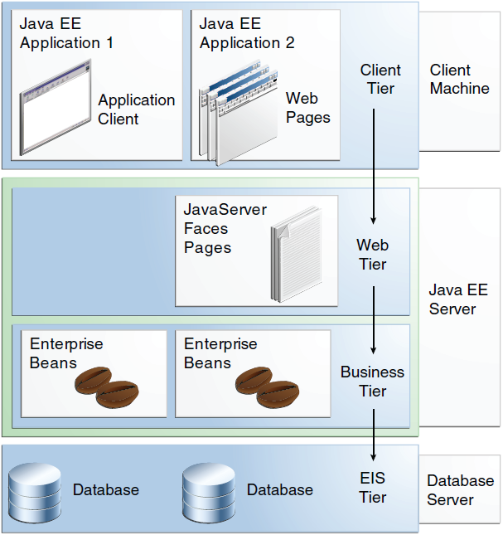

Slide 35
Java EE Servers
(Sun Java Application Server)
A Server Application that Implements the Java EE Platform APIs and provides the standard Java EE Services.
Also called Application Servers, because they allow you to serve Application Data to Clients, much like Web Servers serve Web Pages to Web Browsers.
Host several Application Component types that Correspond to the tiers in a multi-tiered application.
Provides Services to these components in the form of a Container.
Notes:
Pg. No. 17

Slide 36
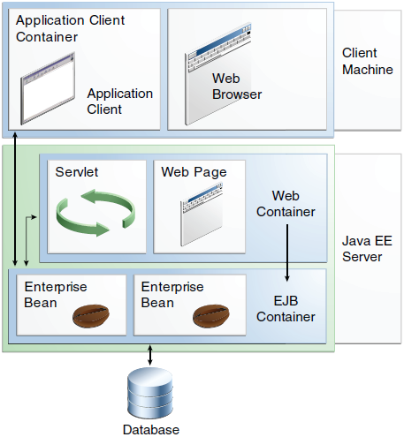

Slide 37
Java EE Containers
Interface between the Component and the lower-level functionality provided by the platform to support that component.
The functionality of the Container is defined by the Platform, and is different for each Component type.
However, the server allows the different Component types to work together to provide functionality in an Enterprise Application.
Notes:
Pg. No. 17

Slide 38
Different Java EE Containers
The Web Container
The Application Client Container
The EJB Container
Notes:
Pg. No. 17

Slide 39
The Web Container
Interface between Web Components and the Web Server.
Web Component can be a servlet, a Java Server Faces Facelets page or JSP page.
The container manages the component's lifecycle, dispatches requests to application components, and provides interfaces to context data, such as information about the current request.
Notes:
Pg. No. 17

Slide 40
The Application Client Container
Interface between Java EE application clients, which are special Java SE applications that use Java EE server components, and the Java EE server.
Runs on the client machine, and is the gateway between the client application and the Java EE server components that the client uses.
Notes:
Pg. No. 18

Slide 41
The EJB Containers
Interface between enterprise beans, which provide the business logic in a Java EE application, and the Java EE server.
Runs on the Java EE server and manages the execution of an application's Enterprise Beans.
Notes:
Pg. No. 18

Slide 42
Reference Books:
Your First Cup: An Introduction to the Java^{(TM)} EE Platform
                - Oracle

